Slide 1
Zonal initiative 2019
Year 2019
Zone : Pabna
ZSM: Md. Naimul Haq

Slide 2
INITIATIVE WILL BE AS BELOW
DISTRIBUTOR CHANGE
DSR CHANGE
DSR REFRESHMENT
MARKET BRANDING
STICKER
RETAIL MEET
CAMPAIGN BY DISTRIBUTOR
ROUTE CHANGE OR ROUTE INCREASE
POS EXPANSION
CO EXPANSION
SBC CHANGE /DEPLOYMENT
DISTRIBUTOR HOUSE UPGRADATION
MARKET SHARE INCREASE BY YOUR INITIATIVE
DISTRIBUTOR ENGAGEMENT IN MARKET
PRODUCTS LAUNCHING BY DISTRIBUTOR
PRODUCTS TRAINING AND SALES TRAINNIG FOR DSR /SBC

Slide 3
AT A GLANCE
INITIATIVE TYPE | WHEN (MONTH /QUARTER) | WHY | OUTCOME | TOTAL COST/ SALES INCREASE
DSR Change | Nov’2019 ( DSR-0026- Ishwardi Market | Negligence of duty | products make possible proper distribution | Sales increase-5%
Retail meet and Inauguration ceremony | Nov’19- Mugdho Corporation Natore | Zonal sales Development | Publicized New Dealer to Retails | The event’s total cost was, 1 lacs plus
Campaign Arrange by Dealer | Quarter 4’19 Best DSR /Manager award,Symphony bijoy offer,Stock clear offer, | For growth Secondary sales and occupied competitors smartphone sales share | Increase sales and clear slow moving smart phone models within short period | Sales increase 10%
SBC Deployment | Nov’19 Grameen Phone Mobile | SBC Deployed | Achievements of Grameen phone mobile Nov-89% & Dec-104% | Sales increase 25%
New Dealer Deployment | Natore /October/19 | Poor performing and unethical practice in the market | Retails satisfied and getting products as demand | Sales increase 20%

Slide 4
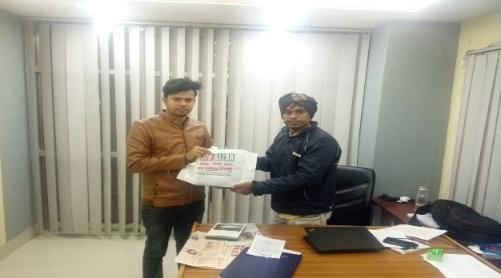
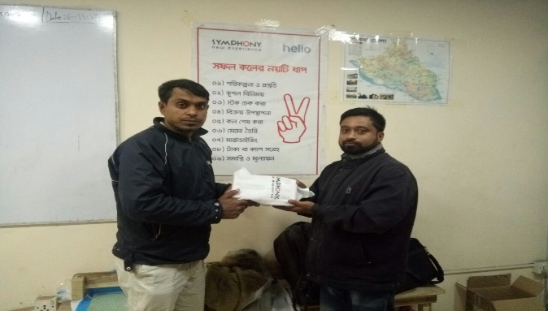
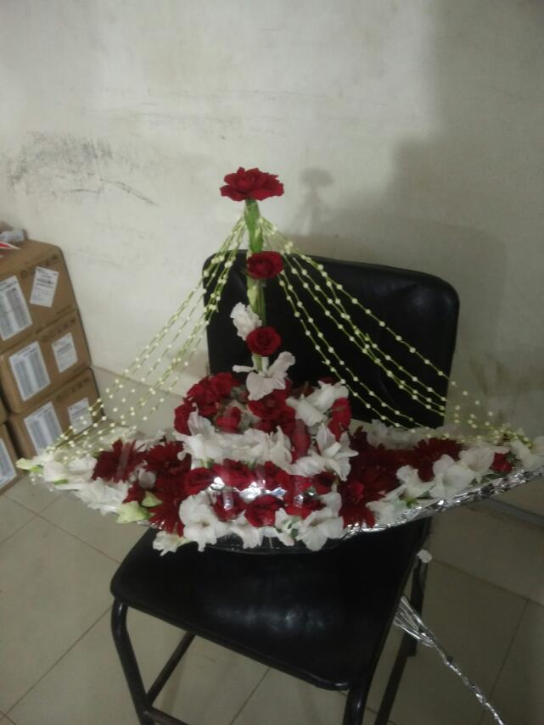
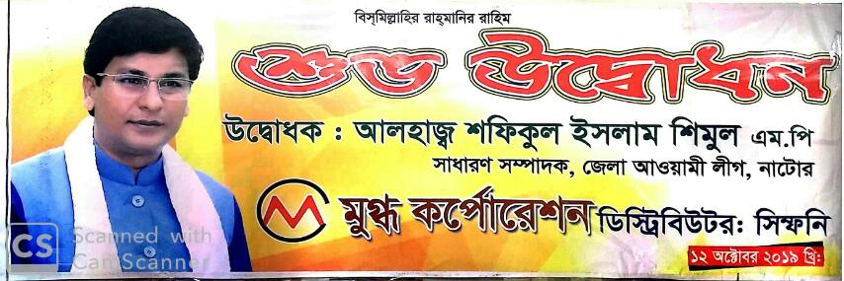
Distributor level
Initiative details
Picture:Best Manager/DSR, New Dealer Inauguration
Mugdho Corporation,Tulip Distribution,Tulip 2 & Swastidip Enterprise
DSR monthly performing recognition
Best Manager Recognition
Retail meet’2019 Under Mugdho Corporation
Symphony bijoy offer under Swastidip Enterprise
DSR incentive on value Sales target Under Tulip Distribution
Extra investment support from Dealer for hit primary double incentive Q4’19
DSR 20/= incentive on smartphone individual model sales Dec’2019
Retail Extra incentive on secondary lifting under Mugdho Corporation Q1’19
1 Litre Soyabean oil free with Smartphone V98 Under Mugdho Corporation
2 Litre Soyabean oil free with Smartphone V98 Under Tulip Distribution

Slide 5
Thank You!

